Slide 1

Maximizing Revenue for Taxi Cab Drivers
A data-driven approach using hypothesis testing & regression analysis for stakeholder presentation.

Slide 2




Business Problem & Objective
Maximize Earnings
Key Question
Objective
Can encouraging certain payments lead to higher fares?
Actionable, data-driven insights for revenue growth
Does payment method impact fare revenue?

Slide 3
Dataset & Data Preprocessing
Source
Cleaning
Key Features
NYC Yellow Taxi Dataset (January 2023)
Removed missing values (2.34%)
Passenger count, trip distance, fare amount, payment type.
Dropped duplicate entries (39.77%)
Cash & Card transactions

Slide 4
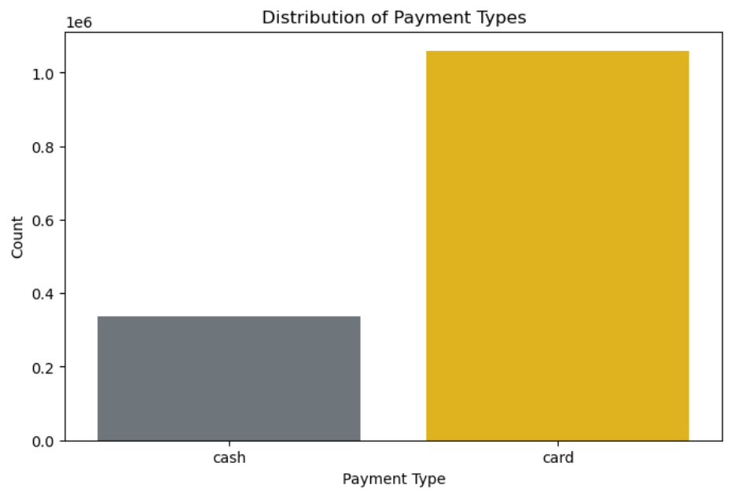
Distribution of
Payment Type
1
Frequency
2
Average
Card payments are more frequent
Cash fares tend to be lower

Slide 5




Hypothesis Testing: Payment Type vs. Fare
H₀
No fare difference
H₁
Payment type affects fare
Result
p-value = 0.00 → Reject H₀
Conclusion
Card payments higher

Slide 6
Regression Analysis: Key Revenue Drivers
Trip Duration
1
Strongest Predictor
Payment Type
2
Cash fares lower

Slide 7

Business Insights & Actionable Recommendations
Findings
Card payments higher
Trip durations increase earnings
Recommendations
Incentivize cashless payments
Optimize pricing strategies

Slide 8

Revenue Optimization Strategy
1
Short-Term
Train drivers on digital payments
Cash payment surcharges
2
Long-Term
Adjust pricing for trips
Track revenue trends

Slide 9
Next Steps & Further Analysis
Analyze peak hours
Include driver behavior trends
Explore external factors

Slide 10

Thank You
Questions & Answers

